Slide 1
R programming
Practices

Slide 2
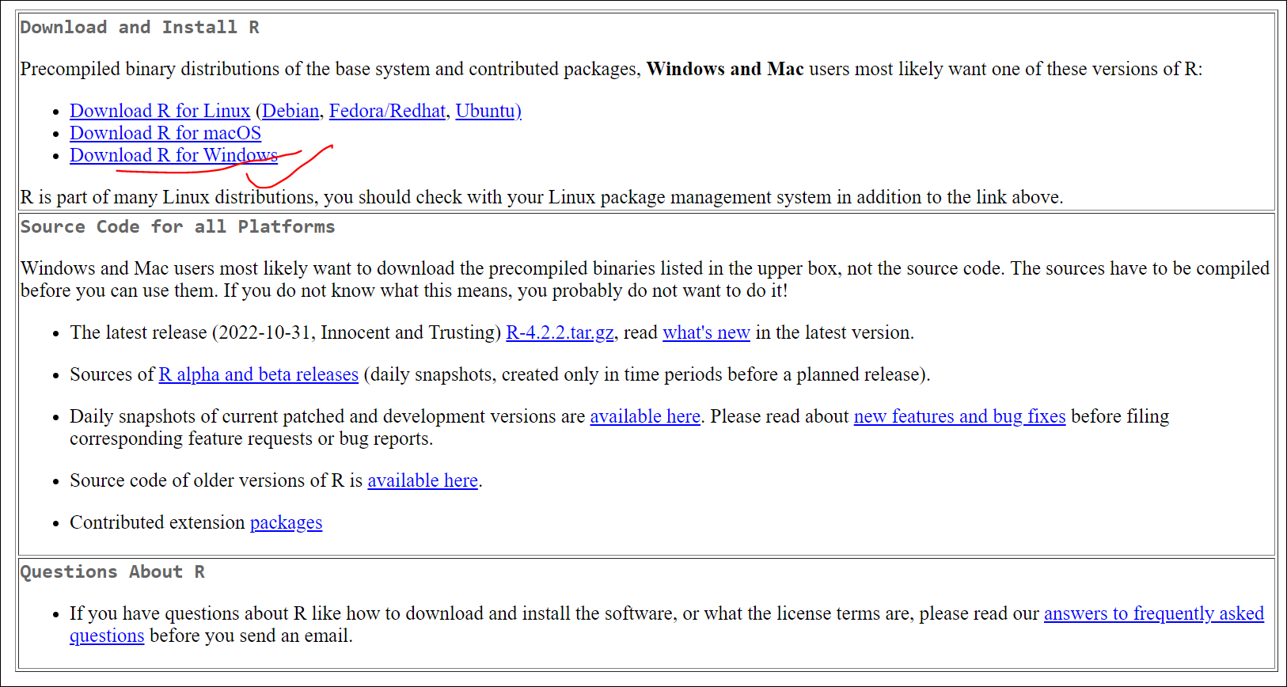
1. Software download and installation
https://cran.r-project.org/
Notes:
Papalexi E and Satija R. Single-cell RNA sequencing to explore immune cell heterogeneity, Nature Reviews Immunology 2018 (https://doi.org/10.1038/ nri.2017.76)

Slide 3
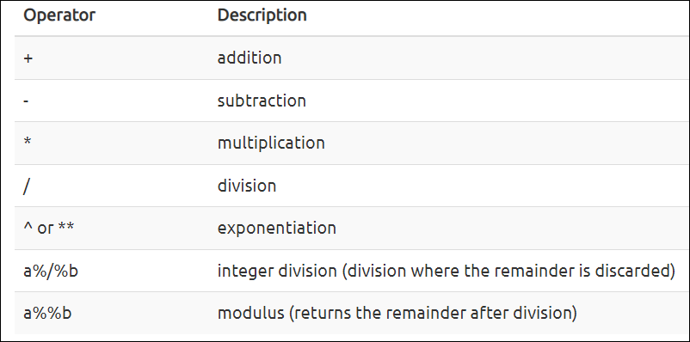
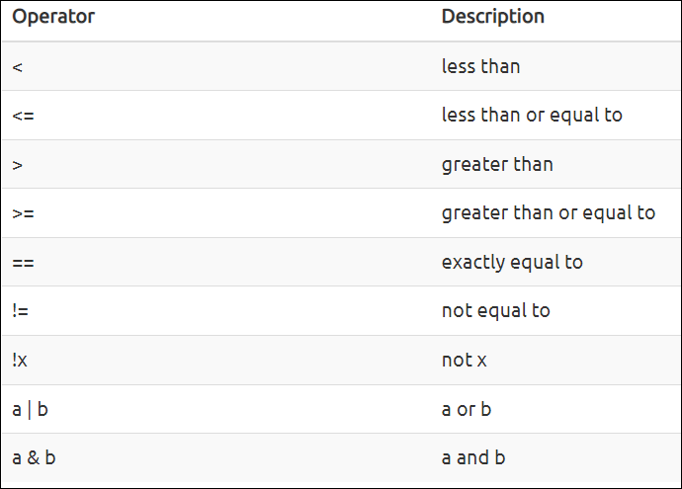
2. Operators
Mathematical Operators
1+3, 3-4, 3*3, 4/3, 3^2, 11%%2, 11%/%2
Logical Operators
1==1, 1>2, 1!=2, ! (1==1), (1==1)|(1==2), (1==1)&(1==2)

Slide 4
3. Variables and related operations
Variable Type
Characters, strings
Numerical value
Logic
NULL
NA
Data structure:
Simple variables (symbol)
Vector (vector)
Data frame (data.frame)
List (list)
Factor (factor)
Matrix (matrices)
Arrays (array)
S4 object

Slide 5
3.1 Simple variables
1->x1 or x1<-1 or x1=1
"1"->x2
"TP53"->x3
TRUE->x4
NULL->x5
NA->x6
Exercise:
Create a numeric variable
Create a variable containing the name of the gene
Create a variable with the URL as the value: "ftp://ftp.ensemblgenomes.org/pub/bacteria/release-39/fasta/bacteria_5_collection/escherichia_coli_b_str _rel606/"

Slide 6
Exercise 1
22->human_chr_number
"EGFR"->gene_name
'ftp://ftp.ensemblgenomes.org/pub/bacteria/release-39/fasta/bacteria_5_collection/escherichia_coli_b_str_rel606/'-> ensemble_url

Slide 7
3.2 Vector
Vector assignment
c("OXTR", "ACTN3", "AR", "OPRM1")->snp_genes.
c("rs53576", "rs1815739", "rs6152", "rs1799971")->snps
c("3", "11", "X", "6")->snp_chr.
c(8762685, 66560624, 67545785, 154039662)->snp_pos
Element addition and removal
snp_genes[2]
snp_genes[c(1,3)]
snp_genes[2:3]
"TP53" -> snp_genes[6] or c(snp_genes, "TP53")-> snp_genes
snp_genes[-5]
Operation of vectors
snp_pos[snp_pos> 100000000]
is.na(snp_genes)
c("ACTN3", "APOA5") %in% snp_genes
interact or setdiff
which(snp_pos > 100000000)

Slide 8
Exercise 2
Q1: Give the types of the following variables
snps
snp_chr
snp_pos
Q2: Adding elements
Add a new element to the snps vector: rs332273
Add new elements to the snp_chr vector: 11
Add a new element to the snp_pos vector: 116792991
Q3:
count the number of elements in snp_genes that are of type NA and remove them
remove the ACTN3 gene from the snp_genes vector and generate a new snp_genes vector
Q4:
Select snp_genes, snps, snp_chr and snp_pos to form the first element of the new vector snp_info.
Q5: Show the new snp_info vector element, giving its variable type

Slide 9
3.3 Data frame
Create a data frame
data.frame("Symbol"= snp_genes, "Chr"=snp_chr, "Pos"=snp_pos. "rs"=snps)->snp_info.
data.frame()->snp_info.
File Read-In
read.table("GSE100797_ProcessedData.txt") -> GSE100797_ ProcessedData
read.csv("2022 IF.csv")->IF_2022.
Common operations
dim(), nrow(), ncol(), colnames(), rownames()
GSE100797_ ProcessedData[1:5,], GSE100797_ ProcessedData[,1:5], GSE100797_ ProcessedData[1:5,1:10]
GSE100797_ ProcessedData$DATA

Slide 10
Common Data Frame Operations
Subset
subset(snp_info,Symbol=="OXTR")
head(GSE100797_ ProcessedData)
tail(GSE100797_ ProcessedData)
snp_info$Symbol
snp_info[snp_info$Symbol=="OXTR",]
Other
str()
summary()
Sort
order()
sort()
max()
min()
Save
write.csv(GSE100797_ ProcessedData, file = "F:/data/SRR2584863_variants.csv",header=T,sep="\t ")
write.table(GSE100797_ ProcessedData, file = "F:/data/SRR2584863_variants.txt",header=T,sep="\t ")

Slide 11
3.4 List
A key property of list is that they can contain multiple types of data, not just variables of only one category. For example, a list can contain both a vector, a data frame, a single variable, or even another list.
Create a List
list(Symbol = snp_genes,refference_snp = snps,Chr = snp_chr,Pos = snp_pos)->snp_data
lapply(), sapply(), etc.
Operations
snp_data$Pos
snp_data$Pos[1]
snp_data[[4]]

Slide 12
3.5 Matrix
Save the same type of data in a two-dimensional array.
Create an array
rbeta(200,shape1=20,shape2=35)*1000->expd.
matrix(expd,nrow=10,byrow=T)->exp_matrix.
paste("sample",1:10,sep="")->rownames(exp_matrix)
paste("gene",1:20,sep="")-> colnames(exp_matrix)
Common operations
dim()
exp_matrix[1:2,]
exp_matrix[,1:5]
apply()

Slide 13
3.6 Factor
Factors (factors) are vectors that are used exclusively for categorical data. In statistical applications, categorical variables and continuous variables are treated in different ways.
It is usually applied when plotting, and is used to display in the desired order, for example, a boxplot expects to follow the order of male and female, you can set the gender variable to factor type and specify the levels as male and female.

Slide 14
4. Process Control
Circulation
for
while
repeat
break
next
Conditions
if, if...else...
ifelse()

Slide 15
5. String object
The operations for a string object is mainly splitting, splicing, replacing, taking subsets, etc.
split
strsplit(x, split, fixed = FALSE, perl = FALSE, useBytes = FALSE)
Combine
paste (... , sep = " ", collapse = NULL)
paste0(... , collapse = NULL)
Replacement
chartr(old = "a",new = "c",c("a123", "a15", "a23"))
sub(" +$", " 12:00", "Now is the time ")
gsub(pattern = "nd",replacement = "ND",c("andbndcnd", "sndendfund"))
Sub-string
substr("abcdef", 2, 4)
substr("abcdef", 1:6, 1:6)
Grep
c("apples x4", "bag of flour", "bag of sugar", "milk x2") -> shopping_list
grep("apple", shopping_list)
grepl("apple",shopping_list)
Other operations
toupper() & tolower()
nchar()
Notes:
https://www.cnblogs.com/sakura-d/p/10938528.html
https://www.runoob.com/r/r-string.html

Slide 16
6. Plotting
Basic plot commands
Plot
Hist
Barplot
Boxplot
Lines
Point
text
Graphical parameters:
Color
type: line type, point type
Style: font, angle
Graphic Components
Axis
Label
Legend
https://r-graph-gallery.com/
https://socviz.co/gettingstarted.html#make-your-first-figure

Slide 17
ggplot2 for data visualization
ggplot2 is a package that makes it easy to create complex plots for data in a data frame. It provides a more procedural interface for specifying which variables to plot, how to display them, and general visual properties. Thus, if the underlying data changes or we decide to change from a bar chart to a scatter chart, we only need to make minimal changes. This helps to create publication quality plots with minimal adjustments.
The gg in "ggplot" stands for "Grammar of Graphics", which is an elegant and powerful way to describe scientific plots. In short, the Grammar of Graphics decomposes each plot into several components, namely a data set, a set of geometries (visual markers representing data points), and a coordinate system. You can imagine this as a syntax that gives unique names to each component that appears in the plot and conveys specific information about the data. With ggplot, the graph is built up step by step by adding new elements.
The concept of mapping is crucial in ggplot. A familiar example is mapping the value of one variable in a dataset to $x$ and another to $y$. However, we often encounter datasets that include more than one (more than two) variables. In such cases, ggplot allows you to map those other variables to visual markers such as color and shape (aesthetics or AES). One thing you may want to keep in mind is the difference between discrete and continuous variables. Some aesthetics, such as the shape of a point, do not accept continuous variables. If forced to do so, R will give an error. This is easy to understand; we can't create a continuous shape for a variable, which is different from, say, color.

Slide 18
7. Installation of external packages
CRAN
The R Comprehensive Archive Network (CRAN) is the largest repository of R packages. CRAN is the default repository for R, and it searches for packages to install.
https://cran.r-project.org/
install.packages()
Bioconductor
For bioinformatics-related packages, it is called Bioconductor, a repository dedicated to bioinformatics packages. The mission is to "facilitate the statistical analysis and understanding of current and emerging high-throughput bioassays".
https://bioconductor.org/
https://bioconductor.org/packages/release/BiocViews.html#___Software
install.packages("BiocManager")
BiocManager::install("vcfR")
GitHub
Github is not specific to R. Any type of code, in any state, can be uploaded. However it does not guarantee that all packages uploaded to github will be successfully installed locally.
https://github.com/
install.packages('devtools')
devtools::install_github()

Slide 19
8. Other advanced applications
Parallel Computing
parLapply
parApply
parSapply
Network Related
Shinny
Web crawler

Slide 20
Useful references
https://datacarpentry.org/genomics-r-intro/
Tidy data
https://r4ds.had.co.nz/tidy-data.html

